Slide 1
LENDING CLUB GROUP CASE STUDY Manish Virmani

Slide 2


Project analysis slide 2
EDA Approach
SHOW PATTERNS IN DATA
UNDERSTAND DATASET
LENDING CLUB
FIND OUT CORRELATION
EXTRACT IMPORTANT VARIABLES
FIND OUT OUTLIERS
DATA CLEANING

Slide 3
Project analysis slide 3
Analysis
Recommendation
Bivariate Analysis
Univariate Analysis
Data Organizing & Cleaning
Note down the spread in default percentage for each variable analysis and at the end, decide based on the variance of this percentage that who are the strong indicators.
Considering the major categories, work with other variables to get better insight
Perform segmented univariate analysis and check the defaulting nature.
Analysing the spread of each numeric variable
Drop all the rows with missing values
Drop all the columns with single values and high missing percentages

Slide 4
Project analysis slide 6
Data Cleaning
We found 54 such columns where all the values were null and removed those columns.
Removed columns with single value through out rows.
Dropped rows for "current“ loan_status as they would not add much value
Dropped few columns as they will not add any value to the data like: 'title','zip_code’ etc.

Slide 5
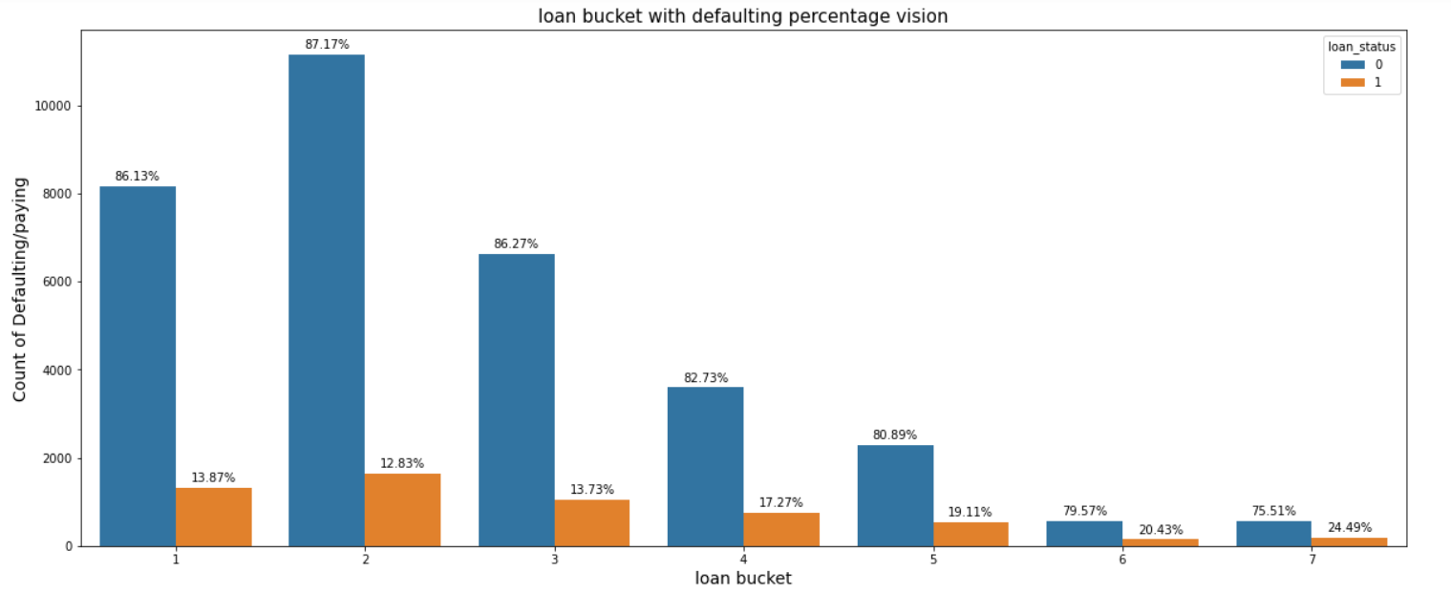
Project analysis slide 5
Univariate Analysis
With this we can see some pattern that above 15,000 (bucket 4) defualting rate is increasing.
Which means that when who have taken higher loan amounts are likely to be contributing towards defaulting rate

Slide 6
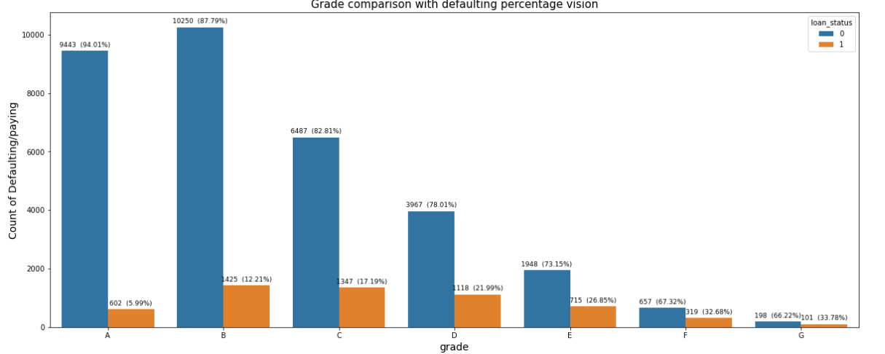
Project analysis slide 5
Univariate Analysis
With this we can analysis that with Grade defaulting pattern is increasing.
We can see that A type loan has very less defaulting rate of 5.99% and Grade G has high defaulting rate.

Slide 7
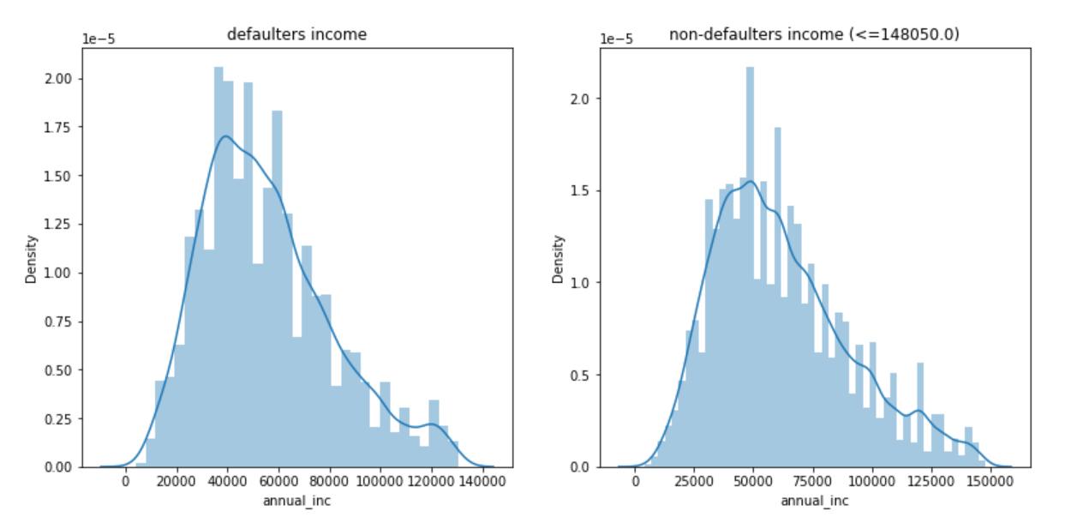
Project analysis slide 7
Univariate Analysis
From histogram we can see there is normal distribution in income of defaulters and non-defaulters

Slide 8
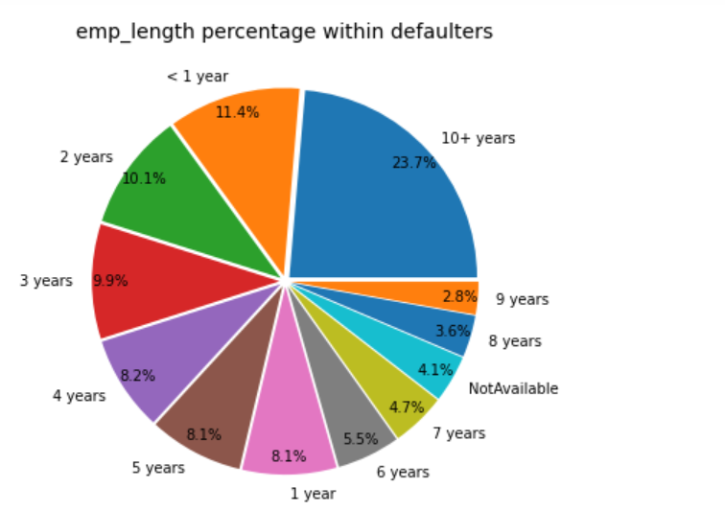
Project analysis slide 7
Univariate Analysis
“
From this pie chart we can see there are maximum defaulters over 10 years of experience

Slide 9
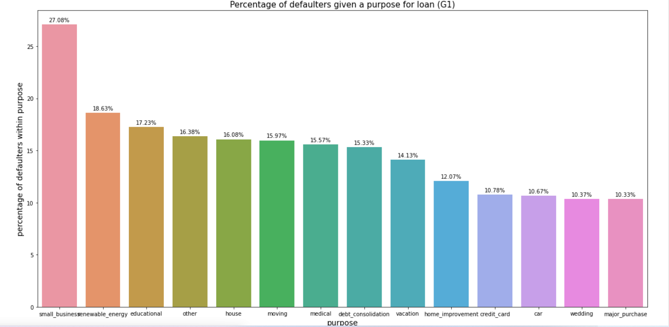
Project analysis slide 7
Univariate Analysis
“
Now we can see that defaulting percentage is higher for small_businesses borrowers i.e. 27.08%

Slide 10
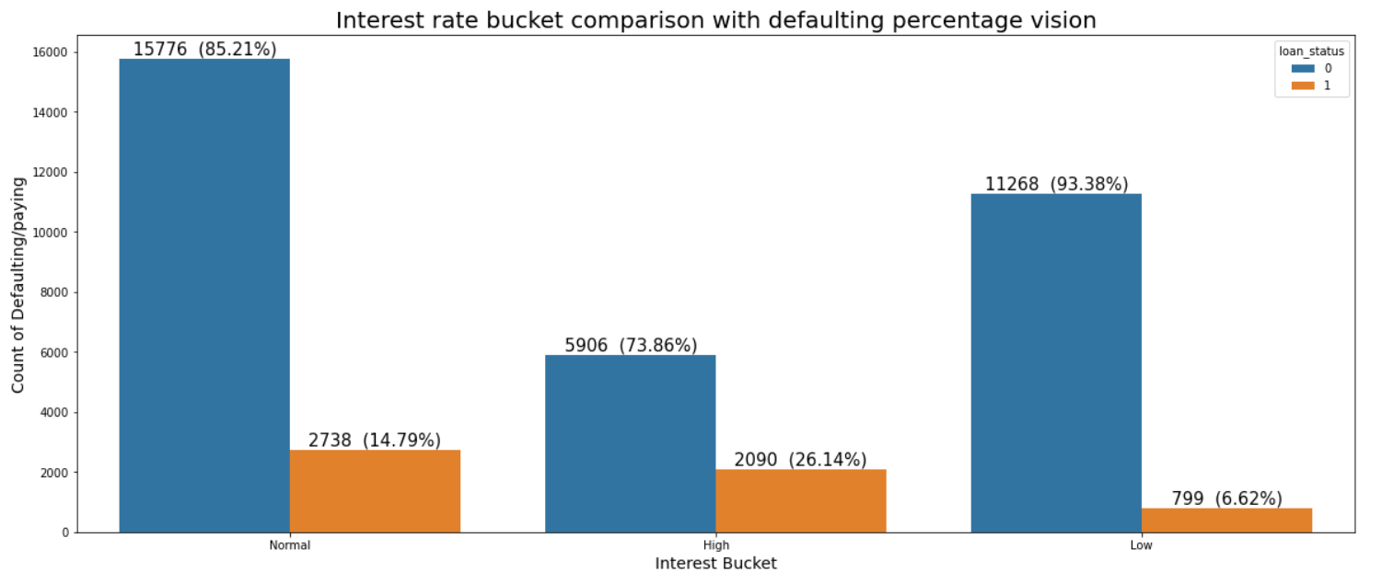
Project analysis slide 7
Segmentate Analysis
“
Now we can clearly see that defaulting percentage increases a lot from one bucket to the other bucket of interest rate
When grouped into three categories, we have observed that the higher the interest rate, more the defaulters.

Slide 11
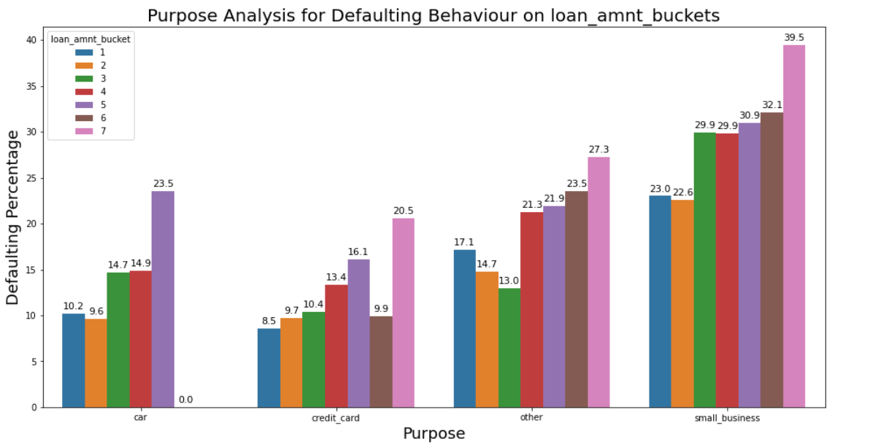
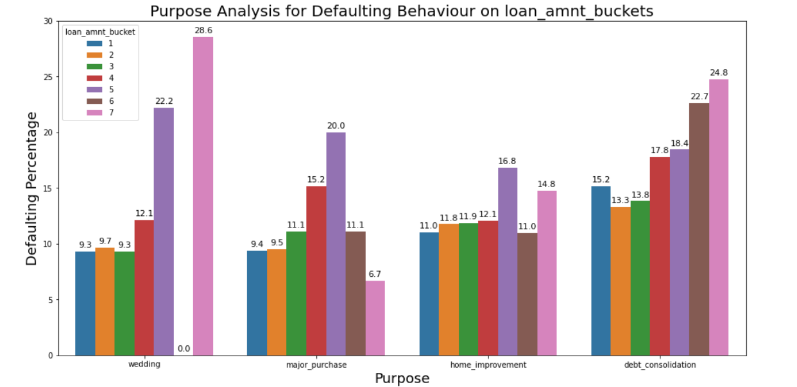
Project analysis slide 7
Bivariate Analysis

Slide 12
Project analysis slide 8
Recommendations
POSITIVE
NEGATIVE
Grade: We can see that A type loan has very less defaulting rate of 5.99%. We can recommend to go with Grade A or B as they have low defaulting rate
Purpose: Giving loans in categories like marriage, major purchase, car and credit card have very less risk. Specially car loans have less default rates.
Loan Amount: We can recommend to provide loan below 15000, as we see less defaulting rate
Interest Rate: its better to give loans in the normal or lower range. -recommended to keep the interest rate below 15% -
Term: It's recommended to give loan for 3 years instead of 5 years , as we see a default spike from 10% to 25% between these two.
Income Bucket: We see less defaulting in between buckets 4-5-6, good to give loans in this range.
Grade: As we go from A to G , the defaulting rate is increasing. It is not recommended to give loan to Grade F and G due to high defaulting rate
Purpose: We saw that borrowers taking loans for small business send up defaulting around 25% of the times.
Loan Amount: We can observe more defaulting higher loan amount loan bracket(7), so it is not recommended to give loans above 30000
Interest Rate: When grouped into three categories, we have observed that the higher the interest rate, more the defaulters.
Employment length: When looked at only defaulter, we see that 10+ years had 23% of them which is huge.
Income Bucket Borrowers with income 5000-10000 are having the highest defaulting percentage, so better to avoid loans in this range.

Slide 13
Thank You

